Slide 1
Student Dropout Prediction System
Predict whether a student will drop out or stay (retained) based on academic, personal, and behavioral factors.

Slide 2
Student dropout is a critical challenge faced by educational institutions worldwide. A significant number of students discontinue their studies due to a combination of academic, financial, and personal factors.
Currently, most institutions identify the issue only after the student has already disengaged or dropped out.
This lack of early prediction systems makes it difficult to:
Identify at-risk students in advance
Provide timely support and intervention
Improve overall student retention rates
As a result, institutions face:
Reduced academic performance metrics
Financial losses
Negative impact on institutional reputation

Slide 3
To address this problem, I developed a Machine Learning-based classification system that predicts whether a student is likely to drop out.
The system works by analyzing multiple factors, including:
Academic performance (GPA, attendance)
Behavioral patterns (study hours, assignment delays)
Socio-economic background (income, scholarships)
🔍 Key Capabilities:
Identifies patterns and relationships in student data
Predicts dropout probability before it happens
This solution enables:
Early identification of at-risk students
Timely intervention strategies
Improved student retention and success rates

Slide 4
DATASET EXPLANATION
📊 Dataset Name:
student_dropout_dataset_v3.csv (kaggle.com)
10000 → Rows
19 → Columns
Feature | Meaning
Age | Student age
Gender | Male/Female
Family_Income | Financial background
Internet_Access | Yes/No
Study_Hours_per_Day | Daily study time
Attendance_Rate | % attendance
Assignment_Delay_Days | Delay in submissions
Travel_Time_Minutes | Time to reach college
Part_Time_Job | Yes/No
Scholarship | Yes/No
Stress_Index | Mental stress level
GPA / Semester_GPA / CGPA | Academic performance
Semester | Year level
Department | Field of study
Parental_Education | Education level of parents
Target Variable:
Dropout (1 = Dropout, 0 = Retained)

Slide 5
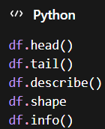
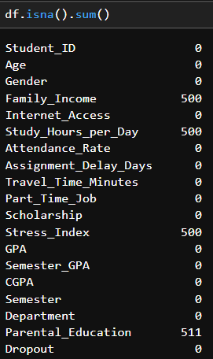
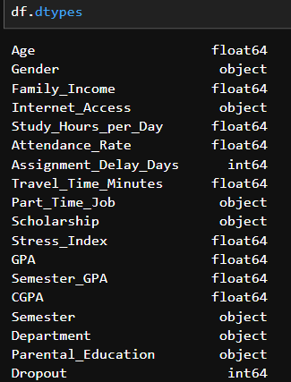
Understanding Data
👉Used to:
Find data dtypes
Identifie objects & numeric
Helps in label encoding
👉Used to:
View data
Check types
Understand distribution
Used to:👈
------------Find null values--------
Family_income → 500
Study_hours_per_day →500
Stress_index→500
Parental_education →511

Slide 6
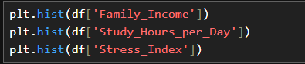
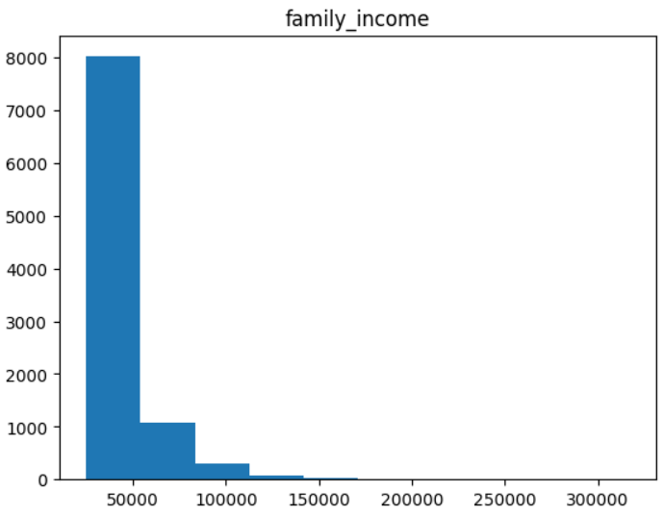
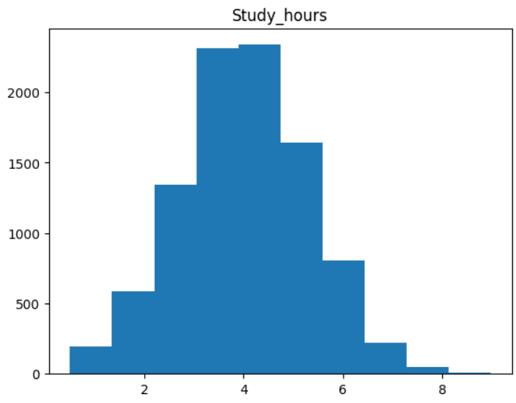
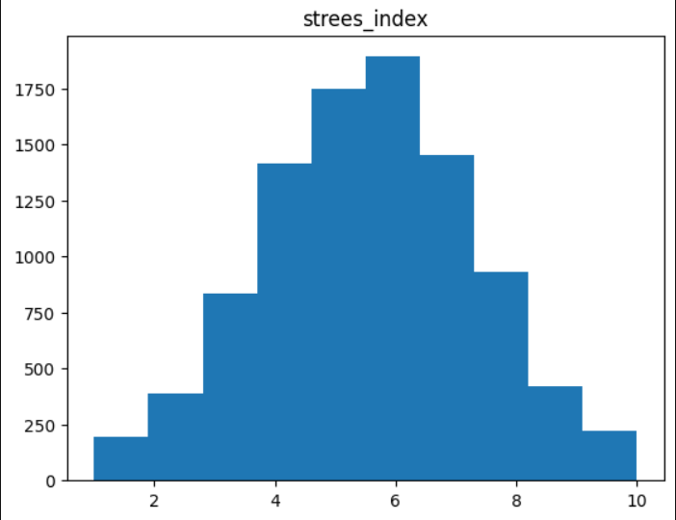
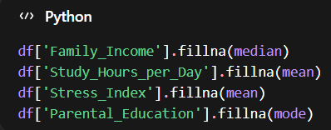
Handling Null Values
👉Used to:
Understand distribution(skewness)
Visualize it using matplolib
Helps in filling null”s using fillna
👉Logic:
Numerical skewed → median
Normal → mean
Categorical → mode

Slide 7
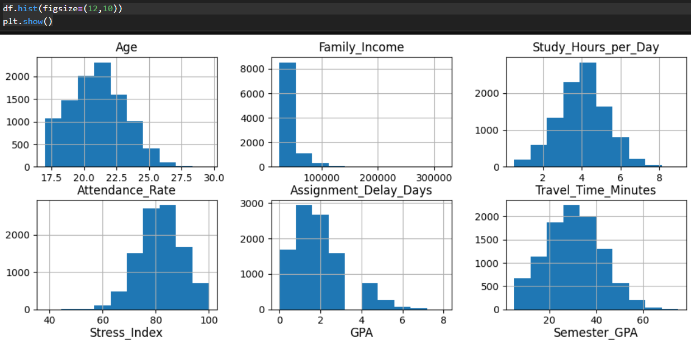
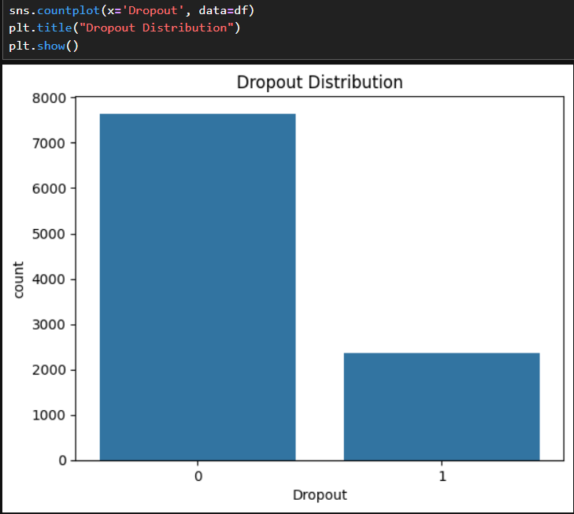
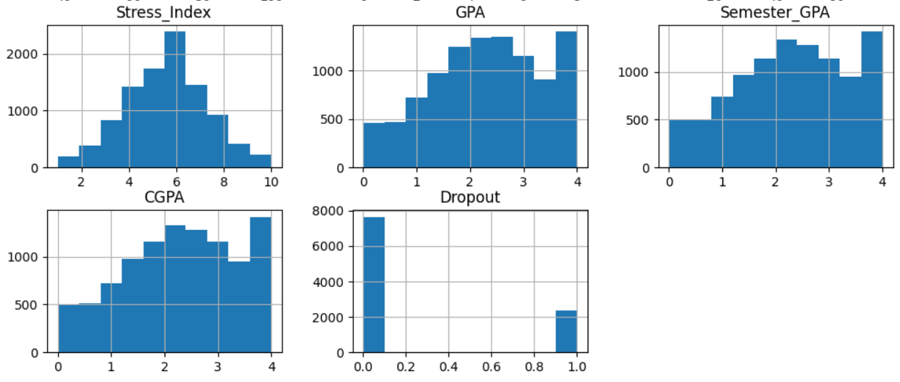
EDA
👉“The countplot shows that the dataset is imbalanced, with more retained students than dropouts. This is important because it can affect model performance and we smote to make it unbiased
👉used histograms to analyze the distribution of numerical features. This helped identify skewness, outliers, and overall data patterns. For example, family income was right-skewed, so I used median imputation, while features like GPA showed near-normal distribution.”

Slide 8
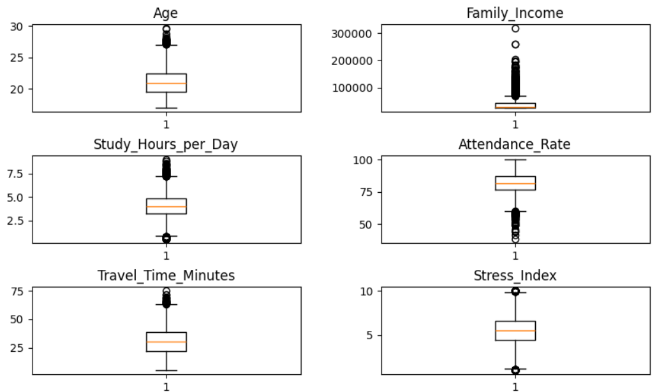
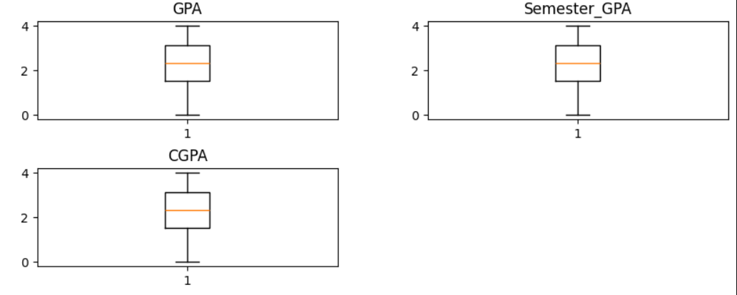
outliers
“Boxplots revealed that features like family income and travel time contain significant outliers, while academic features such as GPA show low-end outliers representing struggling students. removing them could lead to loss of important information.

Slide 9
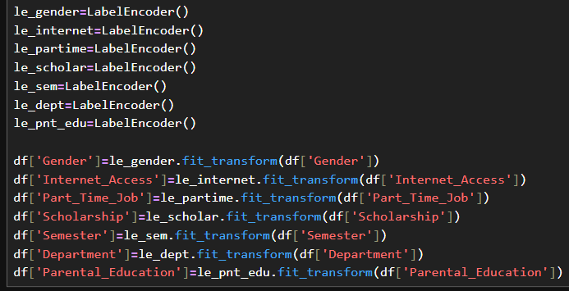
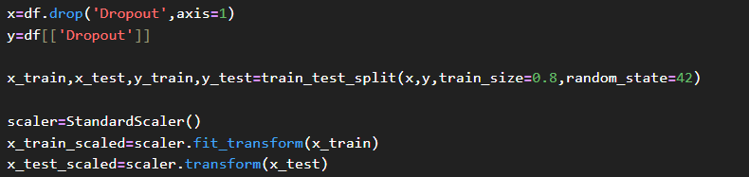
Preprocessing
👉 encoded categorical data
👉Created feature (x) & target (y) variables ,splited the dataset into training and testing sets ,scaled features.”

Slide 10
Models used
Decision Tree
Random Forest
K-Nearest Neighbors (KNN)
Support Vector Classifier (SVC)
AdaBoost
Gradient Boosting
XGBoost

Slide 11
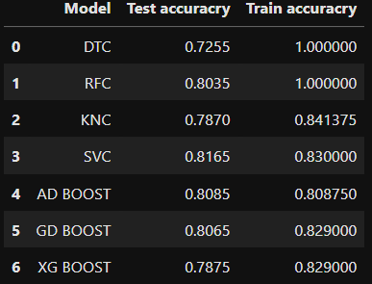
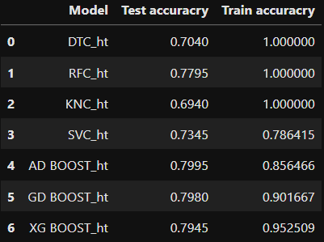
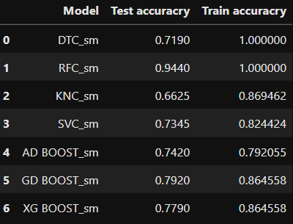
Evaluation
Base modeling
After Hypertunning
After Smote
👉evaluated using accuracy & train score
From the tables it is found that gradientboost classifier is the best model and predicted using it (90%-Train score),(79%accuracy).

Slide 12
Conclusion
Successfully built a machine learning model to predict student dropout
Performed EDA to identify key factors affecting dropout
Found that attendance, GPA, stress, and study habits are major indicators
Applied data preprocessing techniques like encoding and scaling
Compared multiple models to improve prediction performance
Gradient boost classifier provided better accuracy and predicted using it
Deployed the model using Streamlit for real-time prediction
The system can help institutions identify at-risk students early
Enables data-driven decision making in education
“This project demonstrates how machine learning can be used to proactively reduce student dropout and improve academic success.”

